Slide 1
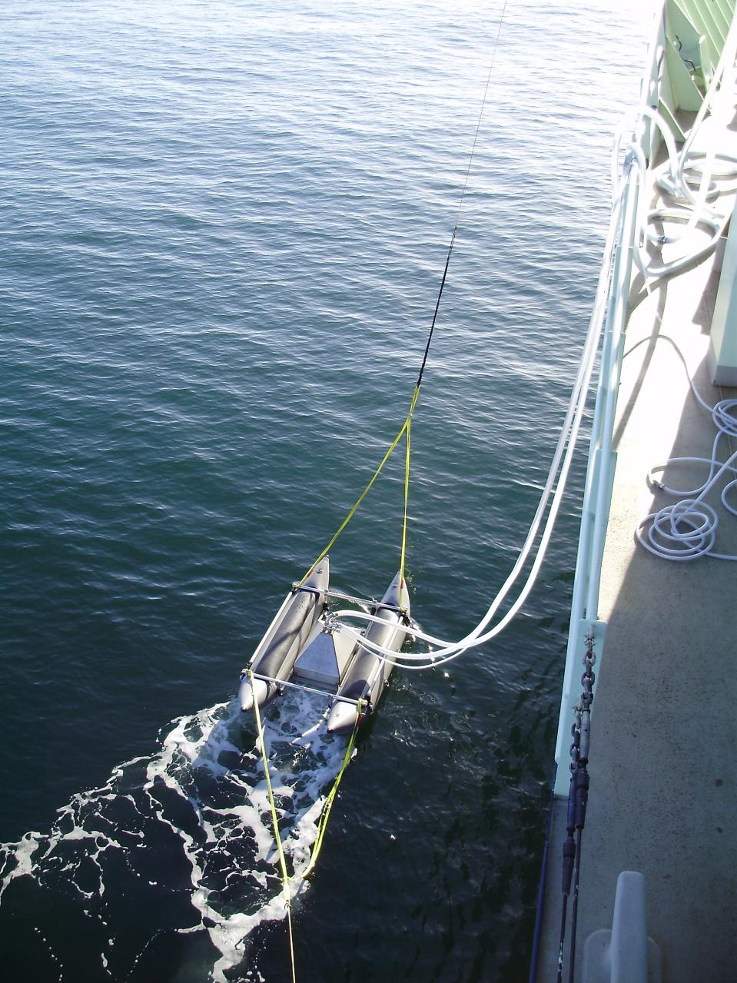
Measurements of Ocean Derived Aerosol off the Coast of California
T.S. Bates, P.K. Quinn, A. Frossard, L.M. Russell, D.J. Kieber, J. Hakala, and W.C. Keene
Notes:
The oceans are a major source of aerosol number and mass to the atmosphere. Over the remote oceans, coarse-mode sea-salt particles dominate aerosol light scattering. Recent measurements suggest that direct emissions of ocean-derived particles also control the aerosol number concentration and thus the aerosol cloud condensation nuclei concentration. Measurements of atmospheric aerosols over the ocean include particles directly emitted from the ocean and particles produced by gas phase reactions in the atmosphere, making it difficult to distinguish between the two sources. Here we report recent measurements of particles directly emitted from the ocean using a newly developed in-situ particle generator/sampler (SeaSweep).

Slide 2
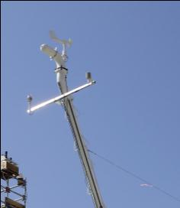
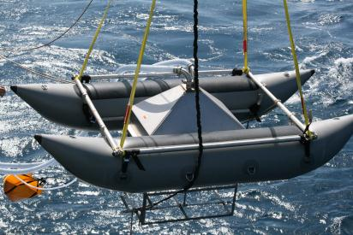
Inlet to
sampling mast
Particle-free air
Air Curtain
Air Curtain to seal off hood from ambient air
Frit ( 1 m below the surface)
Frits 1 m below surface
Notes:
Bubbles were generated 1 m below the ocean surface alongside the research vessel Atlantis off the coast of California and swept into a hood/vacuum hose to feed a suite of instruments on board the ship measuring aerosol physical, chemical, optical, and cloud nucleating properties.

Slide 3
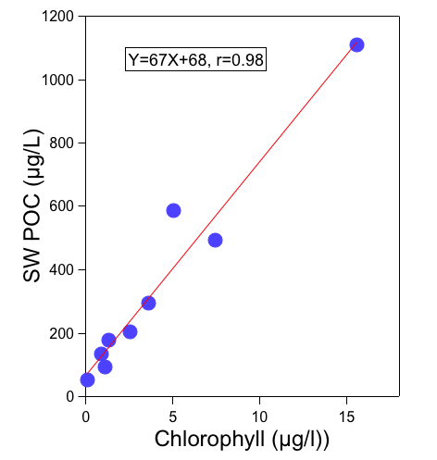
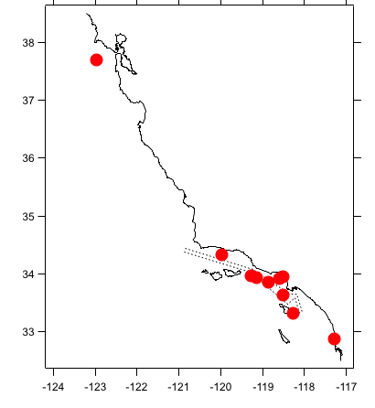
Sea Sweep Deployments
May-June 2010
Notes:
Wide range of chlorophyll and POC concentrations. POC, defined here by what was captured on a glass fiber filter, correlated well with chlorophyll.

Slide 4
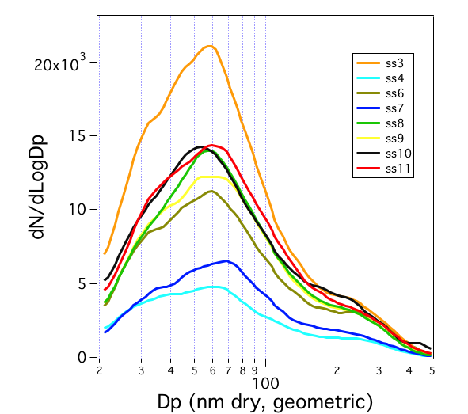
Notes:
The number size distribution of the directly emitted (nascent) particles had a dominant mode at 55-60nm (dry diameter) and a secondary modes at 30-40 nm and 200-300nm.
Height of mode depends on number of bubbles we were capturing. No difference in mode shape with changes in chlorophyll.

Slide 5
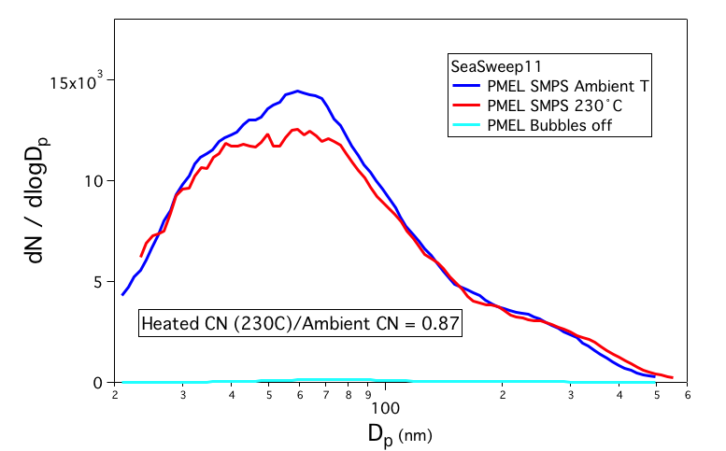
Comparison of unheated (ambient T) and heated SMPS size distributions
90% of the sub-100 nm mode remains after heating to 230°C indicating it is not sulfate or semi-volatile organics.

Slide 6
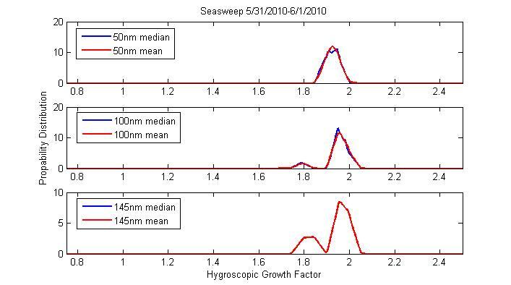
Hygroscopic Growth (dry to 90%RH) of Selected Particle Sizes Jani Hakala, Univ. Helsinki
Aerosol is not internally mixed and is less hygroscopic than pure sodium chloride (GF=2.4)

Slide 7
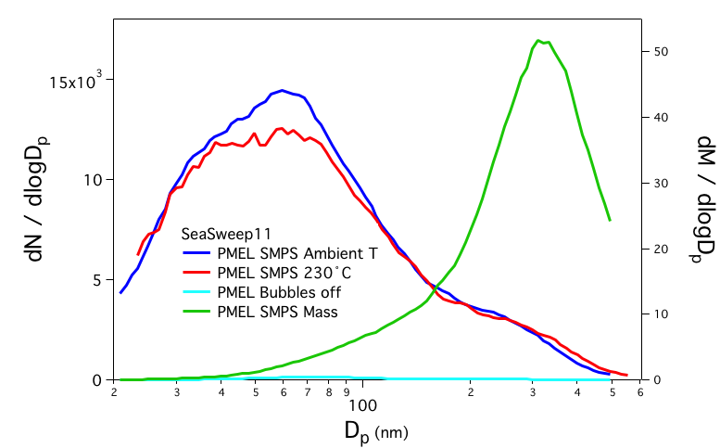
Submicrometer Mass is in the 200-400nm Diameter size range

Slide 8
Submicrometer Sea Sweep 11 Aerosol Composition
Sea salt was > 98% of the total submicrometer mass. Organic carbon was < 2%.
Organic composition was 60% hydroxyl, 20% acid, 14% alkane, and 7% amine (A. Frossard, UCSD), similar to remote ocean measurements (Russell et al., 2010).
But what is the composition of sub-100nm particles that dominate the number concentration?

Slide 9
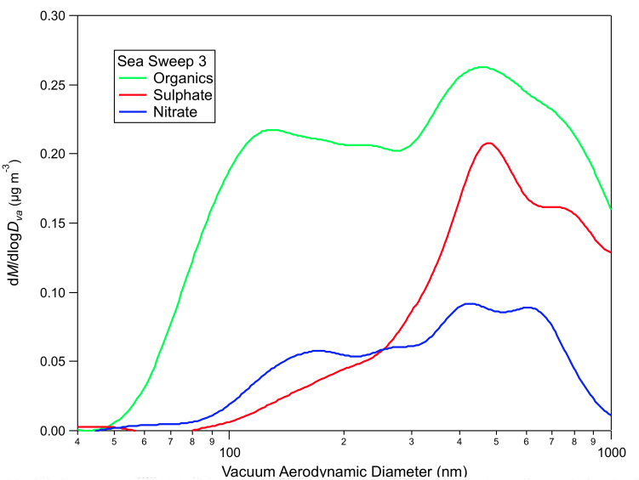
Mass size distributions from the AMS
Sea salt
SO₄ slightly enriched relative to seawater
NO₃ upwelling
Nutrient-rich waters

Slide 10
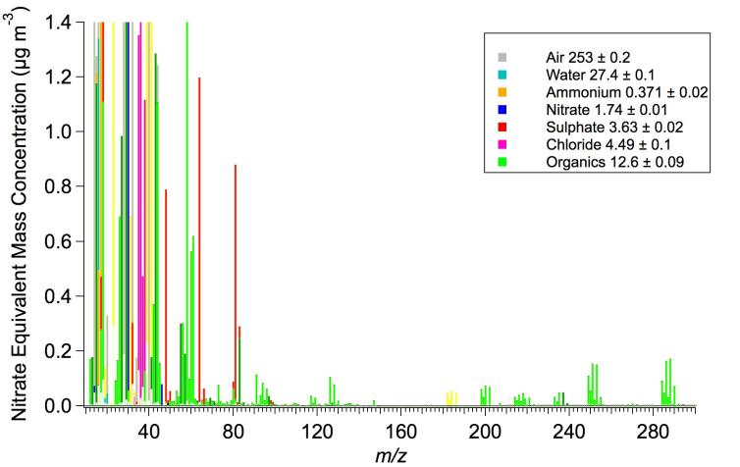
Atomized Seawater Mass Spectrum
Na₂³⁵Cl⁺
Na₂³⁷Cl⁺
35
35
Need to develop sea water fragment waves

Slide 11
Conclusions
The Sea Sweep generated aerosol has a tri-modal number size distribution with modes at 50-60nm, 30-40nm and 200-300nm.
The submicrometer number size distribution and organic carbon content of the sea sweep generated aerosol is not a function of sea water chlorophyll or particulate organic carbon.
The submicrometer number is non-volatile at 230°C and is externally mixed.
The submicrometer organic material was composed primarily of hydroxyl groups.
The method of generating particles at the ocean surface using the Sea Sweep shows promise for assessing the sources, composition, size, and cloud-nucleating properties of ocean-derived aerosol.

Slide 12
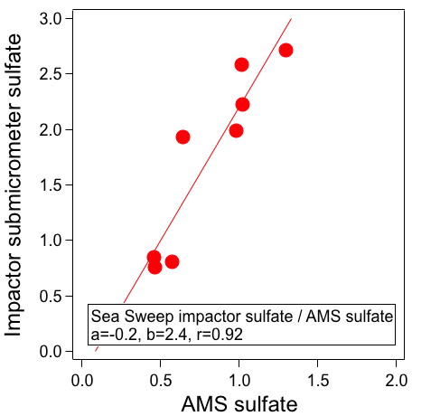
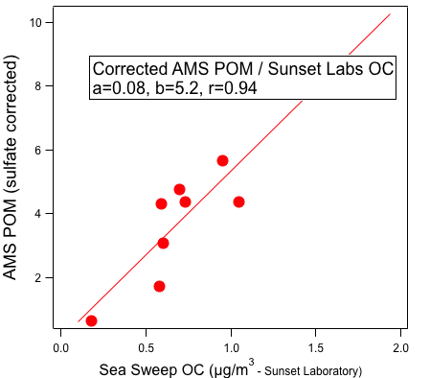
AMS inlet bounce
Non-corrected slope 2.2

Slide 13
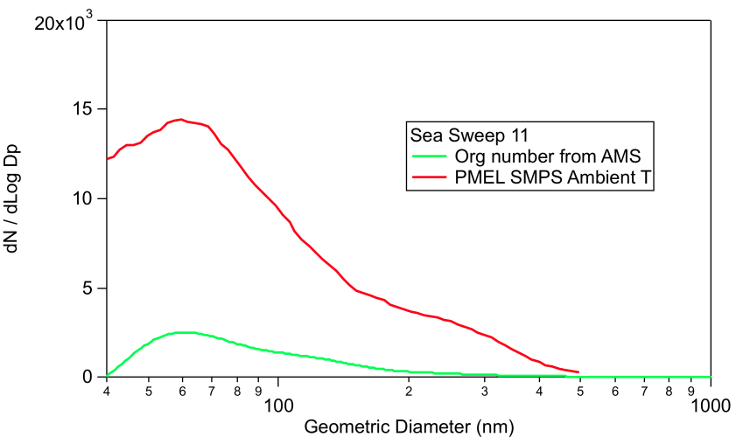
But…conversion of AMS mass to number…….
?

